Slide 1


Java Programming Project Presentation
  Project Title: Clinic Prescription Record And Student Management System
  Course: Java Programming Mini Project
  Student Name & Roll No: Lydia Janet C [25BCS033]
  Department: Computer Science
  Mentor / Guide: Dr.Boopalan Sundaramoorthy

Slide 2
Java Programming Project Presentation
Introduction
Overview of the Project and its Purpose:
• This project is a GUI-based clinic management system developed using Java Swing.
Problem Background and Motivation:
• Store patient details digitally, Track visit time slots, Generate prescriptions, Maintain patient history.
Significance of the Project in Solving Real-World Issues:
• Unlike manual systems, this application ensures fast access, accuracy, and data safety.

Slide 3
Java Programming Project Presentation
Objective
To design a user-friendly GUI system for clinics :
• To store patient and prescription details, avoid double booking of time slots.
• To track patient visits branch-wise and doctor-wise ,
implement file handling for permanent storage

Slide 4
Java Programming Project Presentation
Problem Statement
Current Issue / Gap:
Manual clinic systems have issues like:
Limitations / Inefficiencies:
Paper-based records → easy to lose
No proper tracking of patient visits
Appointment clashes
Time-consuming data search
How the Project Solves It:
Digital storage
Slot booking validation
Instant data retrieval

Slide 5
Java Programming Project Presentation
System Requirements
Hardware Requirements:
• Processor: Intel i3 or above
RAM: 4GB
Storage: 500MB
Software Requirements:
• Language: Java
GUI: Swing
IDE: NetBeans / Eclipse
OS: Windows / Linux

Slide 6
Java Programming Project Presentation
System Design
System Structure & Workflow:
Modules in Your Code:
Patient Entry Module
Appointment (Slot Booking) Module
Prescription Generator
Patient History Table
Dashboard Analytics Module
File Handling Module

Slide 7
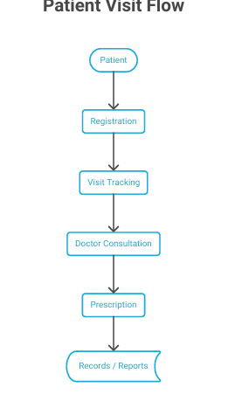
Java Programming Project Presentation
System Design
Block Diagram

Slide 8
Java Programming Project Presentation
Module Description
Input Module:
This module collects user input such as patient personal details, visit information, symptoms, diagnosis, and prescription data required for recording and tracking.
Processing Module:
This module processes the entered data, applies necessary logic, and manages operations like adding new patient records, updating visit details, and organizing prescription histories.
Output Module:
This module displays the processed information, including patient visit history, prescription details, and reports, in a clear and readable format for clinic staff.

Slide 9
Java Programming Project Presentation
Algorithm
Start
Load saved patient data
Display GUI
User enters details
Check slot availability
If available → Add patient
Generate prescription
Display in table
Save data to file
Show dashboard if needed
Exit

Slide 10
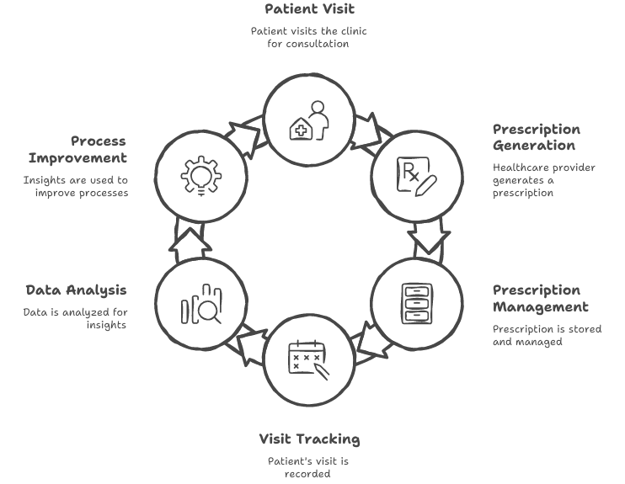
Flowchart
Java Programming Project Presentation

Slide 11
Implementation
Java Programming Project Presentation
The Clinic Prescription Record and Patient Visit Tracking System is implemented using programming techniques that ensure efficient handling of patient data and smooth system operation.
Techniques Used:
• Loops and conditional statements manage the menu-driven system and user interactions such as adding new patients, deleting records, saving data, and viewing the dashboard summary.
• Functions (methods) and collections like ArrayLists are used to store and manage multiple patient records efficiently and to organize the program into modular, reusable components.
• File handling through serialization is used to save patient records to a file and retrieve them when needed, ensuring persistent data storage and management across sessions.

Slide 12
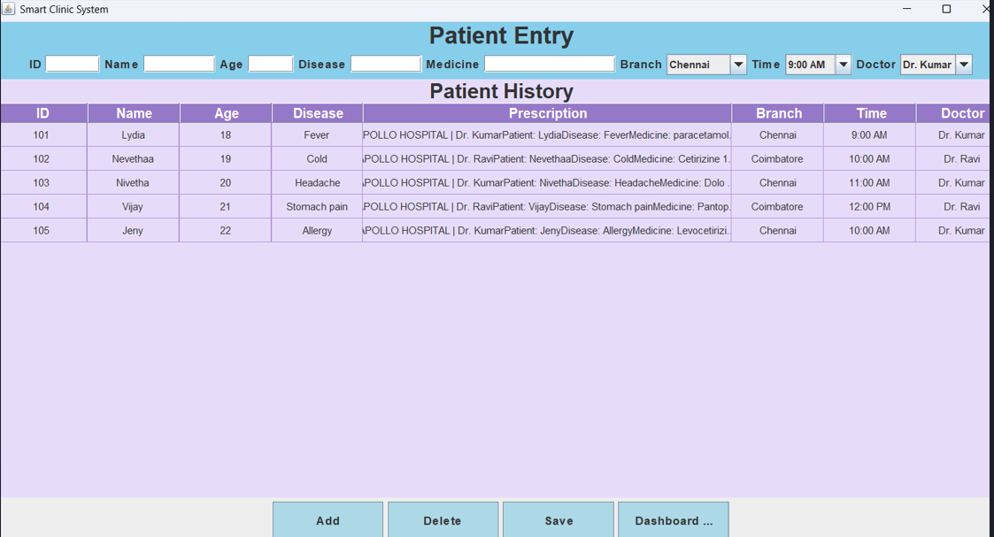
Output Screens
Java Programming Project Presentation
Main Screen of the project

Slide 13
Java Programming Project Presentation
Output Screens
Patient EntryUser enters details

Slide 14
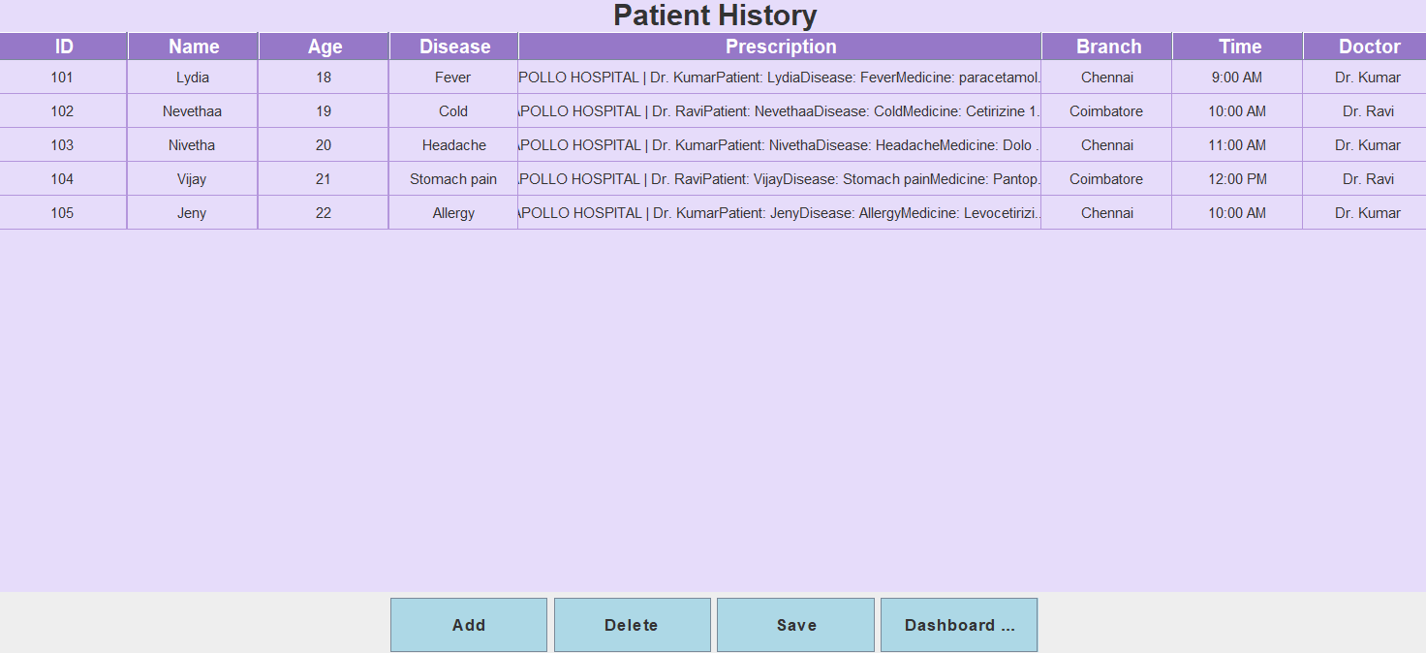
Java Programming Project Presentation
Output Screens
Patient History Table Displays all record

Slide 15
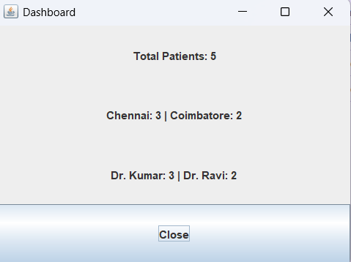
Java Programming Project Presentation
Output Screens
DashboardnTotal Patients

Slide 16
C Programming Project Presentation
Results & Discussion
System works successfully
Prevents duplicate slot booking
Stores data permanently
Easy to use GUI
Challenges:
Managing file storage
Designing UI layout
Handling user input errors

Slide 17
Java Programming Project Presentation
Conclusion & Future Enhancement
Conclusion:
The project successfully implements a Smart Clinic Management System.
It Improves clinic efficiency, Reduces manual work, Prevents appointment conflicts, Provides quick patient access.
Future Enhancements:
Add Search functionality, Edit/Update patient details,Use Database (MySQL) instead of file, Print prescription feature,
Login system for doctors.

Slide 18
Java Programming Project Presentation
References / Acknowledgement
References:
Electronic Health Records: A Practical Guide for Professional
Health Informatics: Practical Guide for Healthcare and Information Technology Professionals
World Health Organization
TutorialsPoint & GeeksforGeeks
Academic project materials and classroom notes
Acknowledgement:
We sincerely thank our project guide and faculty members for their valuable guidance and support in developing the Clinic Prescription Record and Patient Visit Tracking System. We also express our gratitude to our institution for providing the necessary resources. Finally, we appreciate the efforts and teamwork of all members involved in completing this project successfully.

Slide 19
Thank You
“In conclusion, this project demonstrates how automation can simplify clinic prescription record and patient visit tracking system improving efficiency, accuracy, and overall user experience.”

